Slide 1


Studying Aspects of Teamwork and Communication in a Virtual Reality Environment
Jaacob Pledger & Remington Davis
Faculty Mentor: Dr. Heather Lum

Slide 2

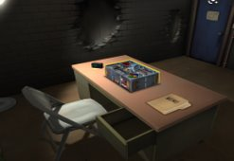
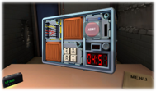
​
ABSTRACT​
This study aims to look at levels of teamwork and communication in virtual reality gaming systems. Researchers hope to analyze participants' communication during the study with the assistance of Virtual Reality. This will allow an experimental view of how subjects interact together when presented with a difficult situation that requires communication to be their top priority if they wish to succeed as a team. Researchers believe that this experiment will allow a better look into the human element of Virtual Reality. This data will prove useful for a variety of applications beyond this study including, but not limited to, consumer, military, and computer-based training simulations. ​

Slide 3
​
INTRODUCTION​
Teamwork and communication are present in most day-to-day activities​
Virtual Reality creates safe and effective training environments​
Use of Virtual Reality has strong applications in the medical field, military, and law enforcement​
Virtual Reality simulates the real world allowing a deeper understanding of human aspects.​
Human Aspects in Research
Workload
Communication
Teamwork
Frustration

Slide 4
​
METHOD​
The study involves a task involving three participants who will need to work together to complete a task. Specifically, three participants will play a game called “Keep Talking and Nobody Explodes” in which they will work as a team to diffuse an imaginary bomb. The goal is to work together and communicate as a team to defuse the bomb before the timer runs out and the bomb explodes. ​
Researchers will collect data on the following.
-Performance data on bomb defusal
-Teamwork data using visual and audio clips.
-Speech content
-Voice Pitch
-Individual perceptions on workload & frustration
-Individual perceptions on teamwork & performance
Participants put into the roles of bomb diffuser & defusal experts
Researchers document how the participants work together and communicate.
The bomb diffuser will describe the device seen in Virtual Reality
Experts navigate bomb defusal manual and attempt to give advice

Slide 5
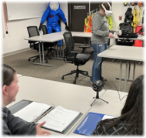
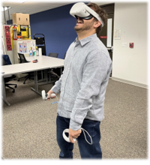
​
DISCUSSION​
The gaming experience is critical to the development and evolution of games as well as an avenue for studying aspects of human behavior. This study aims to look at levels of immersion in a virtual reality gaming system. Researchers hope to establish an experimental plan that will accurately and reliably measure user engagement in the gaming experience as well as emotional and physiological feedback. All these factors will give support for a variety of applications beyond this study including, but not limited to, consumer, military, and computer-based training simulations. ​

Slide 6
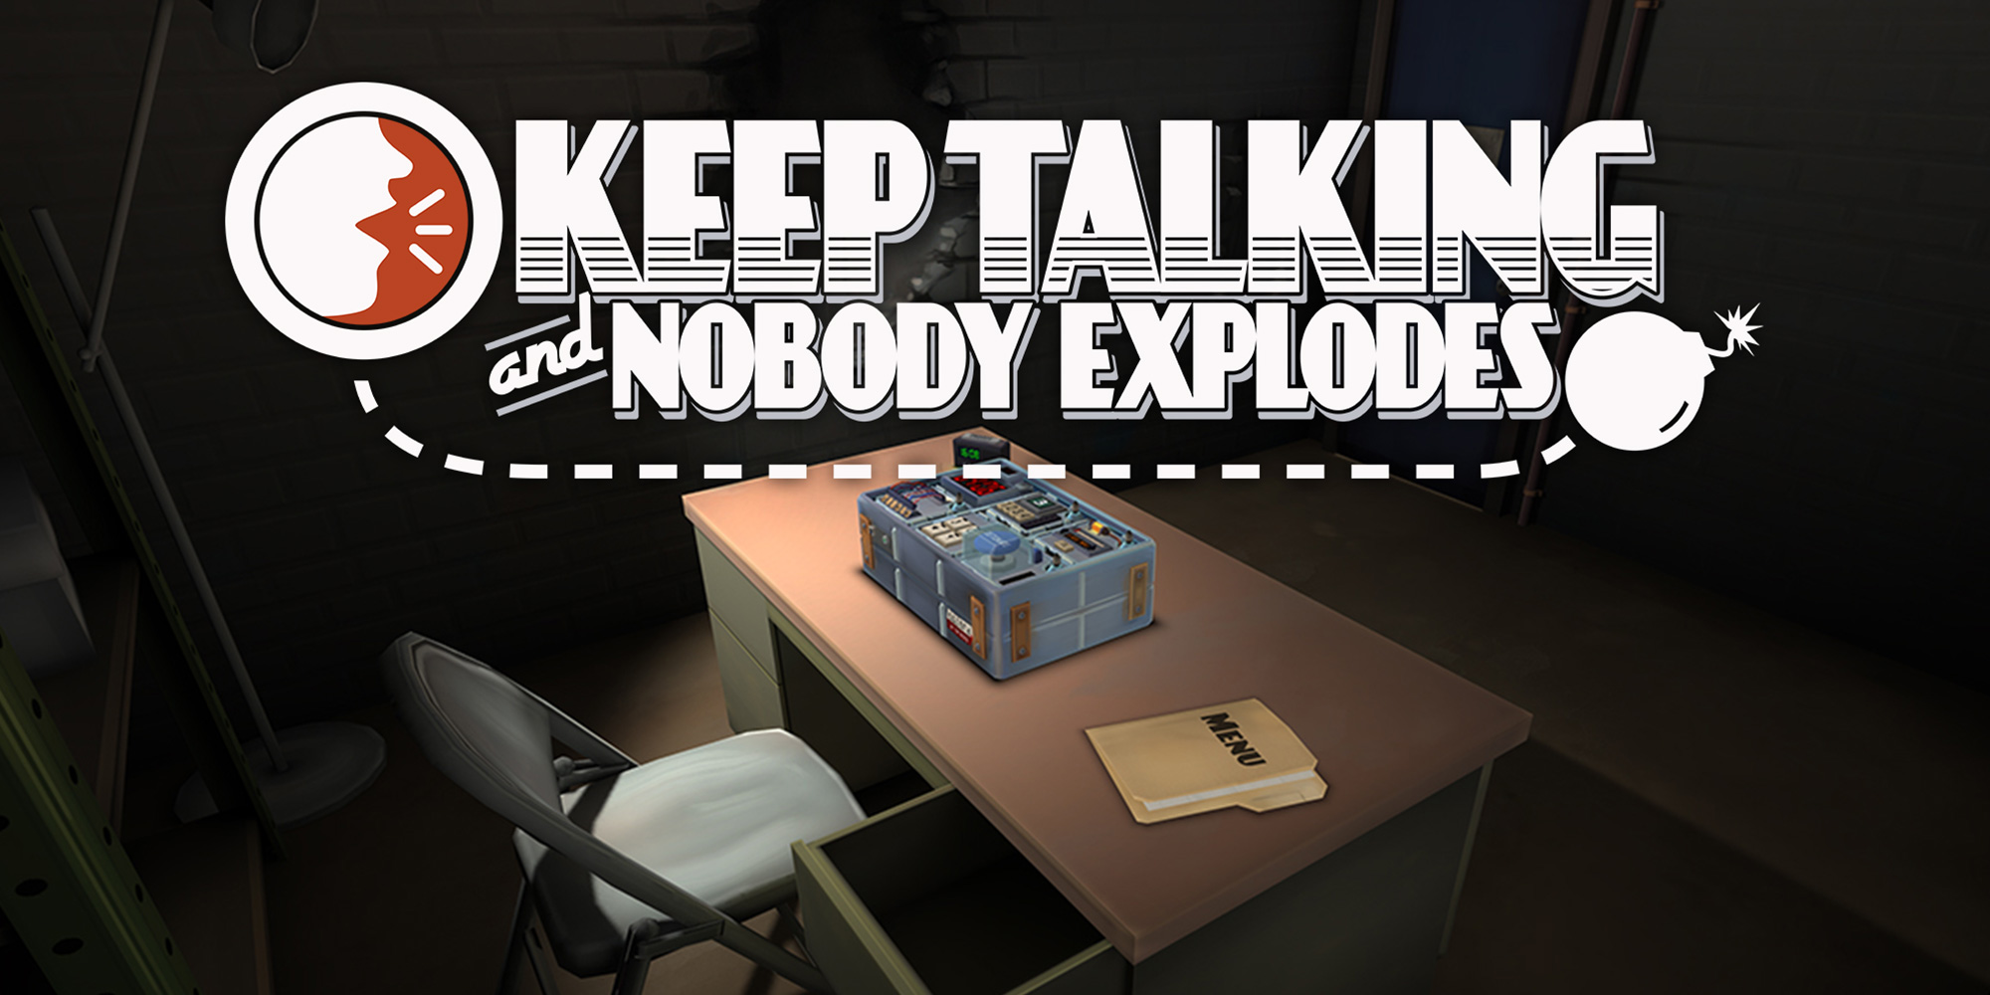
REFERENCES
Ahlberg, G., Enochsson, L., Gallagher, A. G., Hedman, L., Hogman, C., McClusky III, D. A., & Arvidsson, D. (2007). Proficiency-based virtual reality training significantly reduces the error rate for residents during their first 10 laparoscopic cholecystectomies. The American journal of surgery, 193(6), 797-804.
Seymour, N. (2002). Virtual Reality Training Improves Operating Room Performance. Annals of Surgery, 458-464.

Slide 7


